Slide 1
LED Indication Drivers
GAM.PHI Internal Project
18 Apr 2023

Slide 2


1
1
Overview
2
EB Tresos Configuration
CONTENT
3
Port Pin Diagram
4
Code Implementation
© Copyright FPT Software – Level of Confidentiality

Slide 3
01. Overview

Slide 4

Head Light
A head light is a type of light located on the front of a car or other vehicle. It is typically white or yellow in color and is used to illuminate the road ahead of the vehicle, particularly in low light conditions such as at night or in foggy weather.
The LED Driver for the car head light will be configured in EB tresos as: Head_L and Head_R
Figure 1 Head Light of a Car

Slide 5
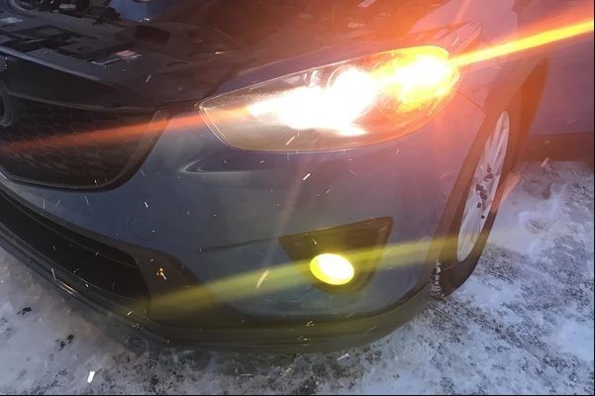
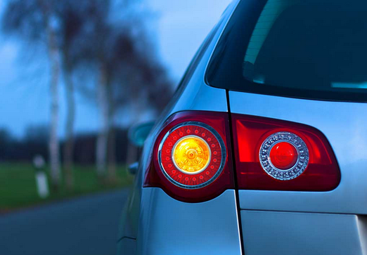
Front and Rear Signals
The front and rear signal, also known as the turn signal or indicator, is used to indicate the driver's intention to turn left or right while driving on the road.
The front and rear signal improves road safety by informing other drivers and pedestrians of the driver's intended direction, allowing them to take necessary precautions and avoid accidents.
The LED Driver for the car front and rear signals will be configured in EB tresos as: FrontSignal_L, FrontSignal_R, RearSignal_L and RearSignal_R
Figure 2 Front and Rear Signal of a Car

Slide 6
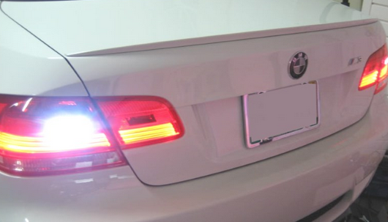
Reverse Signal
The reverse signal light is used to indicate that the driver is backing up the vehicle. It illuminates the area behind the car, allowing the driver to see any obstacles or hazards and navigate safely in reverse.
The reverse light improves road safety by warning other drivers and pedestrians of the driver's actions, especially in busy parking lots or streets. It helps them to take necessary precautions and avoid collisions or accidents with the reversing vehicle.
The LED Driver for the car reverse signal will be configured in EB tresos as: Reverse_L and Reverse_R
Figure 3 Reverse Signal of a Car

Slide 7
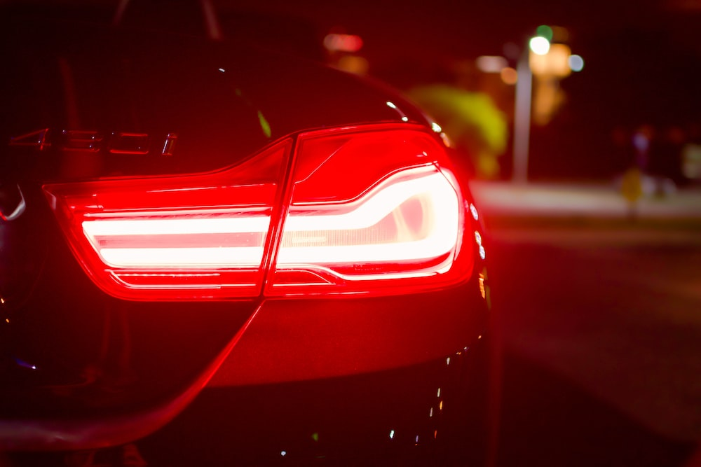
Brake Signal
The brake signal, also known as the brake light, is used to indicate that the driver is slowing down or stopping the vehicle.
The break signal improves road safety by warning other drivers and pedestrians of the driver's actions, allowing them to take necessary precautions and avoid collisions or accidents.
The LED Driver for the car brake signal will be configured in EB tresos as: Brake_L and Brake_R
Figure 4 Brake Signal of a Car

Slide 8
02. EB Tresos Configuration

Slide 9
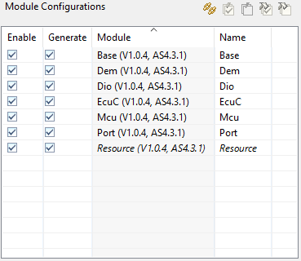
EB Tresos Configuration
For the LED Indication Drivers, the following modules are used:
Base: Provides basic functionality
Dem: Enables communication with ECUs.
Dio: Used for digital I/O handling.
EcuC: Provides an interface between the ECU and the configuration tool.
Mcu: Enables configuration of microcontroller peripherals
Port: Enables configuration of port pins
Resource: Enables configuration of system resources

Slide 10
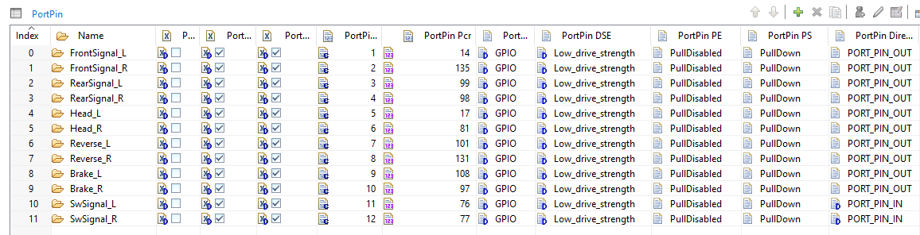
EB Tresos Configuration
The following Port Configuration is used:
Note: Switch configured here are for testing purposes only.

Slide 11
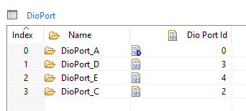
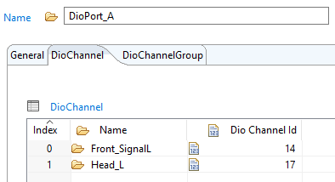
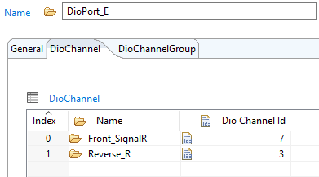
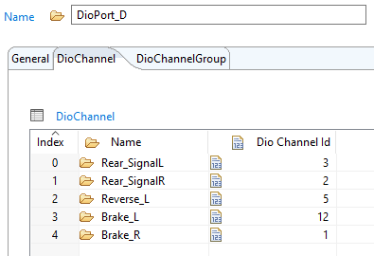
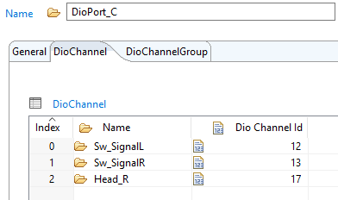
EB Tresos Configuration
The following DIO Configuration is used:
Note: Switch configured here are for testing purposes only.

Slide 12
03. Port Pin Diagram

Slide 13
Port Pin Diagram
The following table shows the port pin mapping for the LED Indications:
LED Indication | Port | PortPin PCR | Triggered State | Default State
FrontSignal_L | PTA14 | 14 | Blinking | OFF
FrontSignal_R | PTE7 | 135 | Blinking | OFF
RearSignal_L | PTD3 | 99 | Blinking | OFF
RearSignal_R | PTD2 | 98 | Blinking | OFF
Reverse_L | PTD5 | 101 | Blinking | OFF
Reverse_R | PTE3 | 131 | Blinking | OFF
Head_L | PTA17 | 17 | Toggle | OFF
Head_R | PTC17 | 96 | Toggle | OFF
Brake_L | PTD12 | 108 | ON | OFF
Brake_R | PTD1 | 97 | ON | OFF

Slide 14
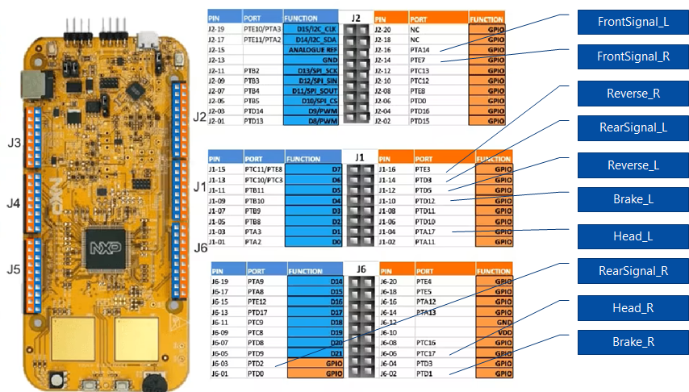
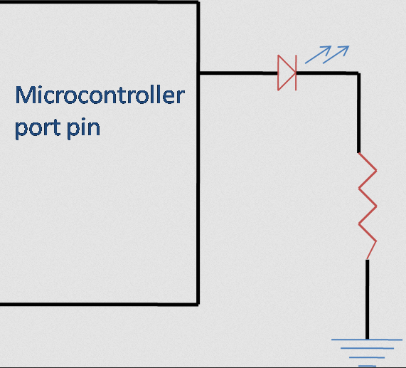
Port Pin Diagram
The following picture shows the pins for the LED Indications:
LED Interface Diagram

Slide 15
04. Code Implementation

Slide 16
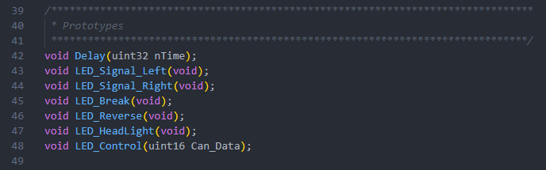
Code Implementation
The following are the prototypes for the LED Driver in ledindication.h:

Slide 17
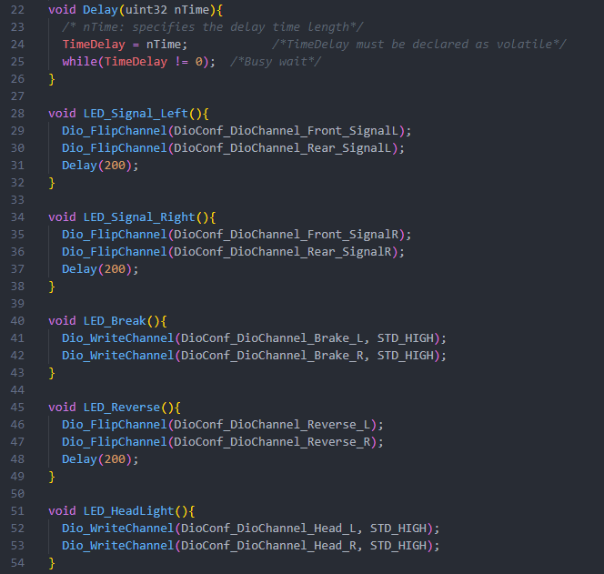
Code Implementation
The following snippet shows the code for the following driver functions in ledindications.c:
Delay
LED_Signal_Left
LED_Signal_Right
LED_Brake
LED_Reverse
LED_HeadLight

Slide 18
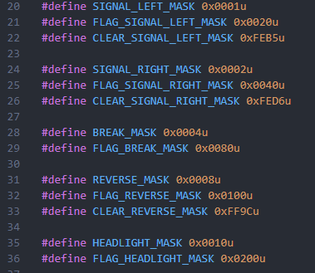
Code Implementation
The following are the masking definitions used for the LED Driver:

Slide 19
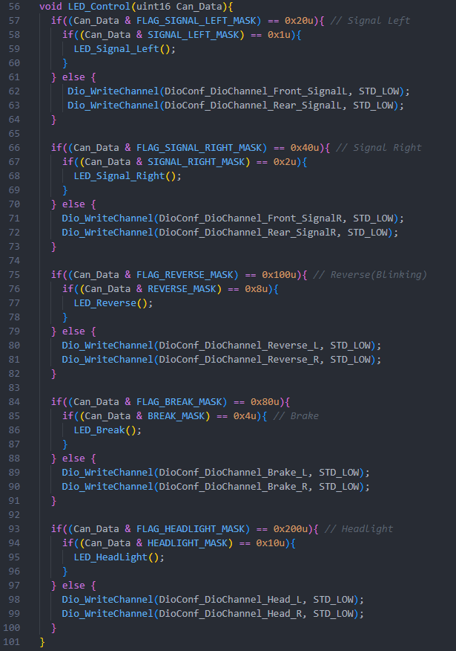
Code Implementation
The following snippet is the code for LED_Control, the main LED driver in ledindications.c :

Slide 20

CONTACT US
FPT Cau Giay Building, Duy Tan Street, Dich Vong Hau Ward, Cau Giay District, Hanoi City, Vietnam Tel.: +84 (24) 3 768 9048 Fax: +84 (24) 3 768 9049

